Slide 1

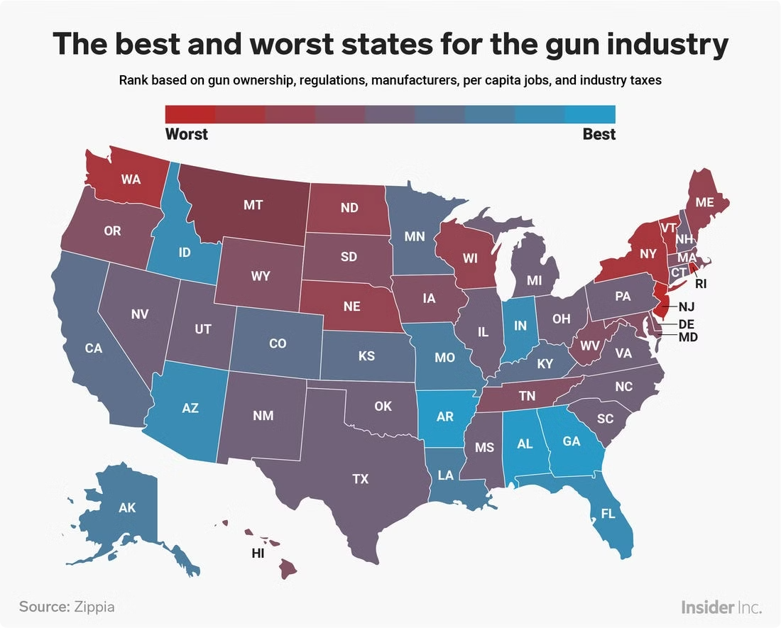

Gun Laws and Firearm Mortality: A State-by-State Analysis
This study investigates the relationship between gun law strictness and firearm-related deaths across US states. We aim to answer a critical question: Do stricter gun laws result in fewer firearm deaths?
by Waheeb Algabri

Slide 2
Data Sources
Firearm Mortality Data
Gun Law Rankings
Sourced from the National Center for Health Statistics (NCHS) API. It covers age-adjusted firearm-related injury data for US states from 2022 to 2024.
Obtained from Gifford's Law Center Gun Law Scorecard. The rankings use a 5-point Likert scale based on law strictness.

Slide 3


Methodology
1
Data Wrangling
Extracted firearm death rates per state by quarter. Mapped gun law grades to a Likert scale for consistency.
2
Data Merging
Combined firearm mortality data with gun law data for comprehensive analysis.
3
Analysis Tools
Utilized Python libraries: Pandas, Seaborn, Matplotlib, and Folium. Conducted correlation analysis using Pearson correlation coefficient.

Slide 4

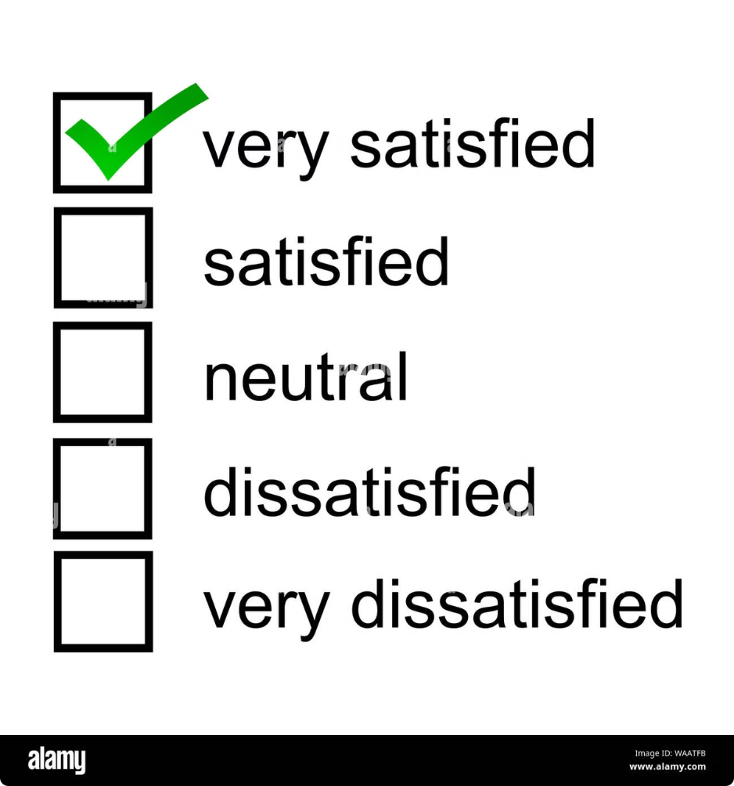
Gun Law Strictness Grading System
Grade
Likert Scale
Description
A/A-
5
Strictest laws
B/B+
4
Stricter than average
C/C+
3
Average strictness
D/D+
2
Less strict than average
F
1
Most lax laws

Slide 5

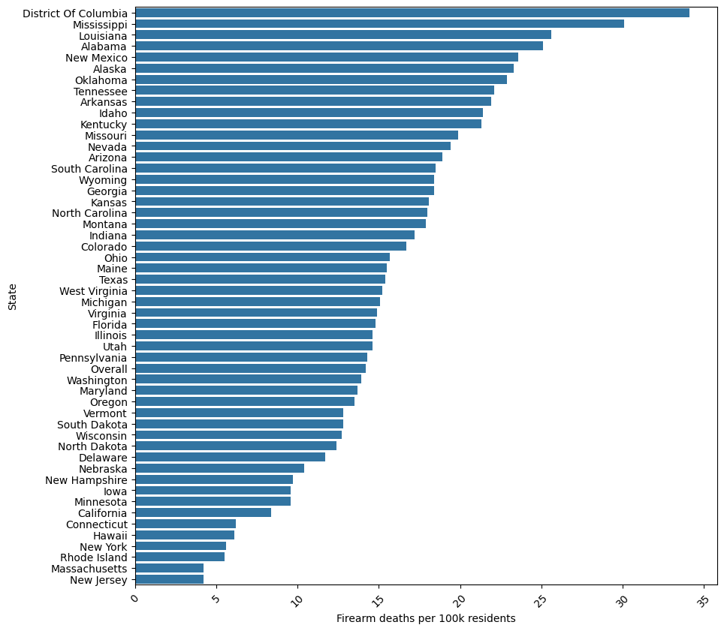
Firearm Mortality by State
1
Highest Rates
District of Columbia, Mississippi, and Louisiana top the list for firearm death rates per 100,000 population.
2
Lowest Rates
New Jersey and Massachusetts demonstrate significantly lower firearm-related death rates.
3
Key Observation
A clear disparity exists across states, potentially linked to differences in gun law stringency.

Slide 6

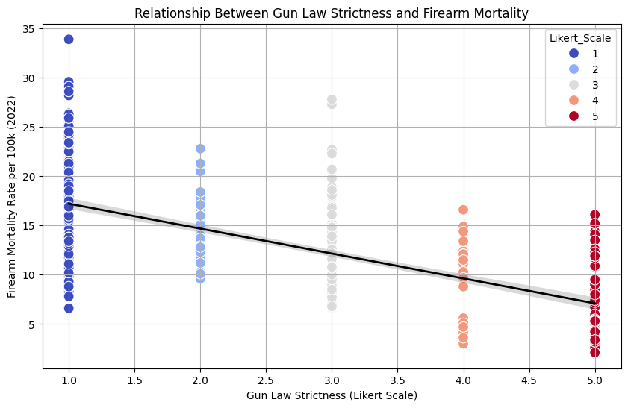



Correlation Analysis
Data Visualization
Scatterplot with regression line shows relationship between gun law strictness and firearm mortality rates.
Correlation Coefficient
Pearson correlation coefficient of -0.67 indicates a strong negative correlation.
Caption
Interpretation
States with stricter gun laws tend to have significantly lower firearm mortality rates.

Slide 7

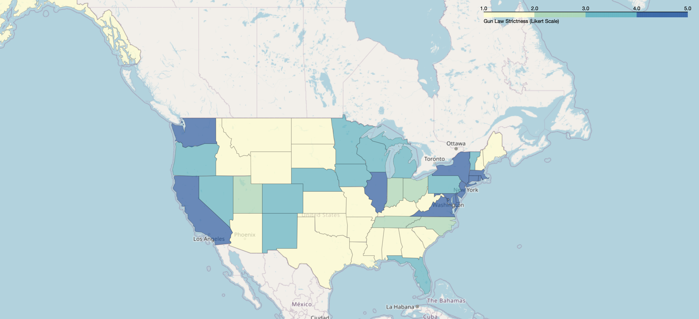
Interactive Map: Gun Law Strictness
Choropleth Map
Displays US states colored based on gun law strictness, from strictest (dark) to laxest (light).
Interactive Features
Popups show state names and their respective gun law strictness scores.
User Engagement
For a better view, kindly open the link
file:///Users/waheebalgabri/Downloads/us_gun_law_map_interactive-23.html

Slide 8





Key Findings
Statistical Significance
P-value of 2.34e-67 indicates a highly significant negative correlation between gun law strictness and firearm deaths.
Strong Negative Correlation
As gun law strictness increases, firearm-related deaths decrease substantially across US states.
Caption
Policy Implications
Findings suggest that stricter gun laws may be an effective strategy for reducing firearm-related deaths.

